Slide 1

COMPUTER NETWORKING
LAB 8

Slide 2
VLAN Configuration

Slide 3
OBJECTIVES
Assign port interfaces to become access and trunk ports. Create VLANs.
Configure VLAN tagging over ports using the hybrid port link type. Configure the default VLAN for an interface using the Port VLAN ID.

Slide 4
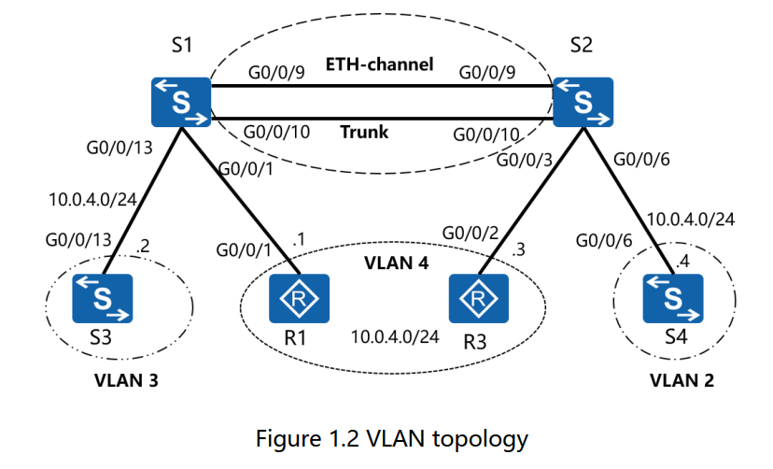
Topology

Slide 5
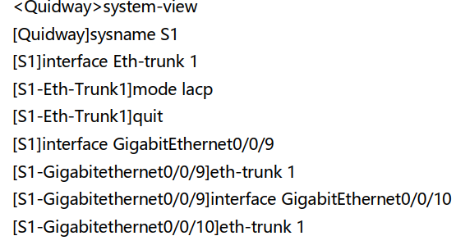
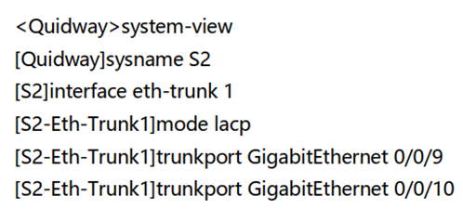
Preparing the environment
establish an Eth-trunk link between S1 and S2
On s2, add interfaces to an Eth-Trunk view

Slide 6
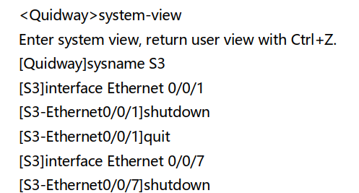
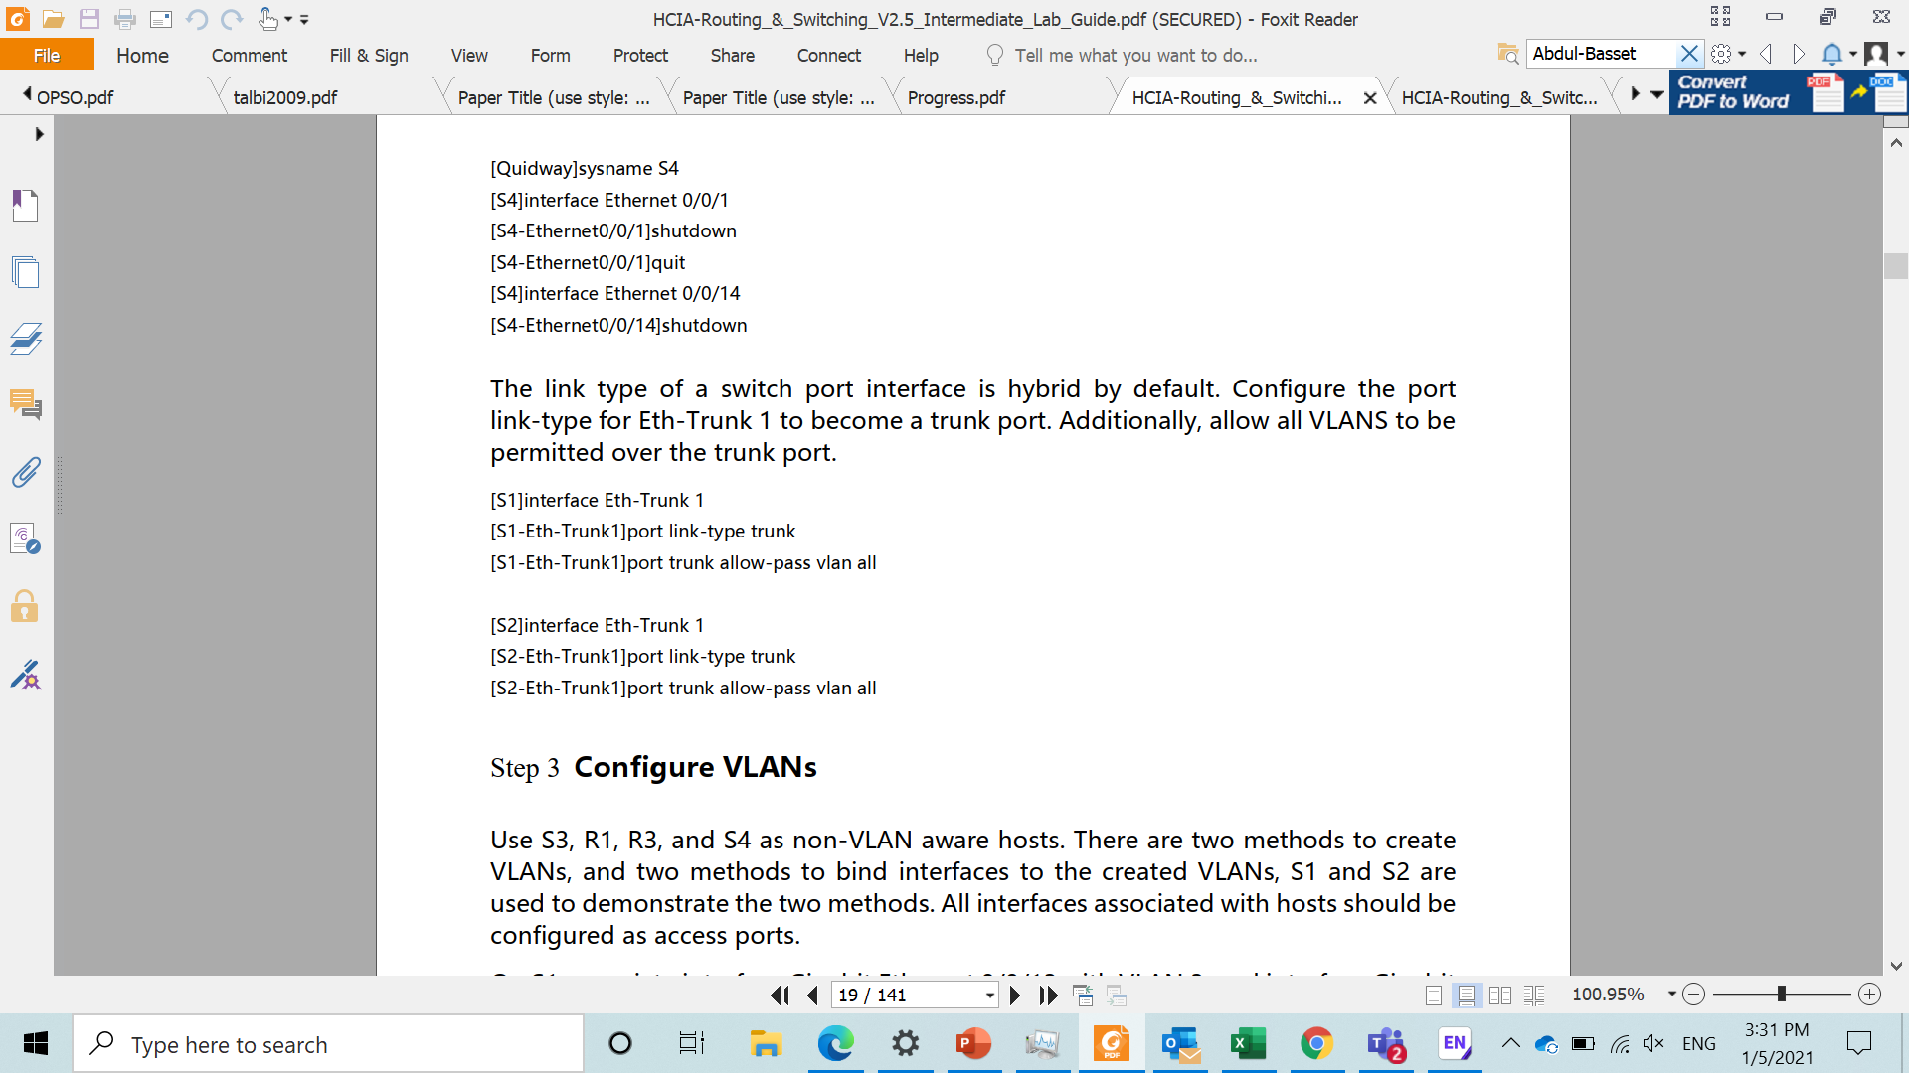
Disable unused interfaces and establish a VLAN trunk
Unused interfaces must be disabled to ensure test result accuracy.
In this lab, interfaces Ethernet 0/0/1 and Ethernet 0/0/7 on S3, Ethernet 0/0/1 and Ethernet 0/0/14 on S4 need to be shutdown.

Slide 7
Disable unused interfaces and establish a VLAN trunk
The link type of a switch port interface is hybrid by default.
Configure the port link-type for Eth-Trunk 1 to become a trunk port.
Additionally, allow all VLANS to be permitted over the trunk port.

Slide 8
Configure VLANS
Use S3, R1 and S4 as non-VLAN aware hosts.
There are two methods to create VLAns and two methods to bind interfaces to the created VLANs, S1 and S2 are used to demonstrate the two methods.
All interfaces associated with hosts should be configured as access port.
on S1, associate interface Gigabitethernet 0/0/13 with VLAN3, and interface Gigabitethernet 0/0/1 with VLAN4.
on S2, associate interface Gigabitethernet 0/0/3 with VLAN4, and interface Gigabitethernet 0/0/6 with VLAN2.

Slide 9
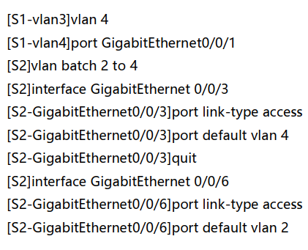
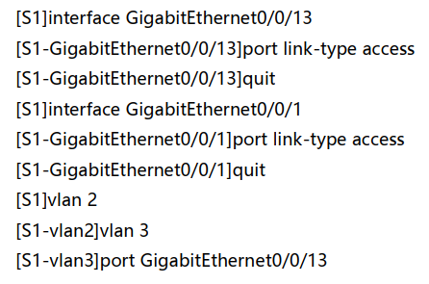
Configure VLANS

Slide 10
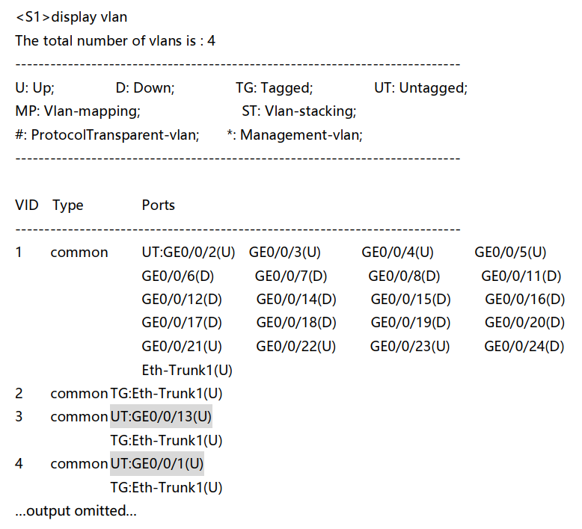
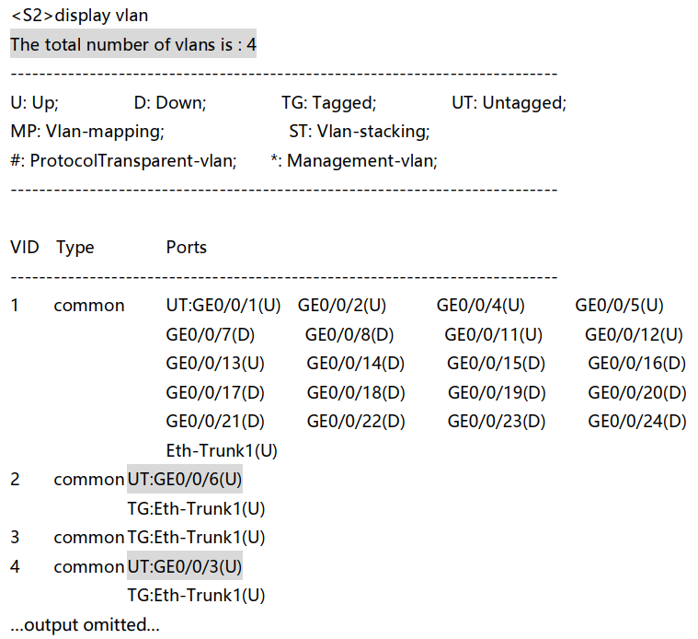
Configure VLANs
Verify that the VLAN configuration has been correctly applied to S1 and S2.

Slide 11
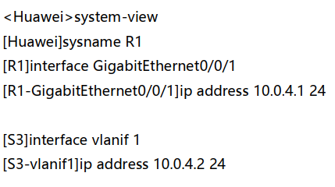
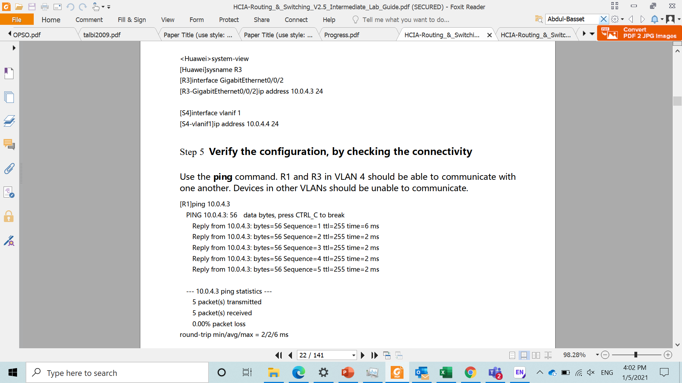
Configure IP address for each VLAN
Configure IP addresses on hosts, R1, S3, R3 and S4 as part of the respective VLANs.
Physical port interfaces on switches cannot be configured the native management interface Vlanif1 with the IP address for the switch.

Slide 12
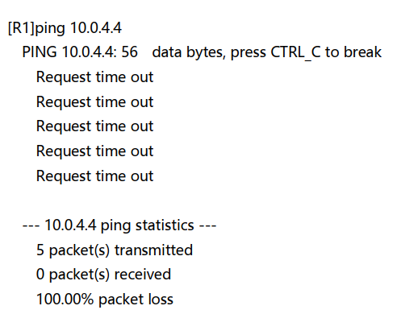
Verify the configuration by checking the connectivity
Use the ping command, R1 and R3 in VLAN 4 should be able to communicate with one another.
Devices in other VLANs should be unable to communicate.

Slide 13
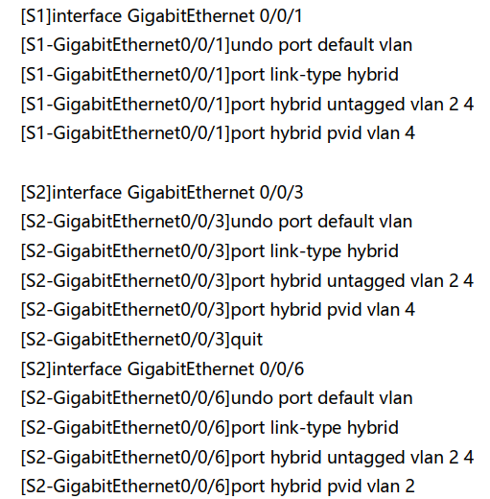
Configured a hybrid interface
Use the hybrid port link type to allow VLAN tagging to be closely managed at a port interface level.
We shall use hybrid ports to allow tagged frames from VLAN 4 to be received by VLAN 2 and vice versa.
Set the port link type of port interface Gigabitethernet 0/0/1 of port S1 and the interfaces Gigabirethernet 0/0/3 and 0/0/6 of S2 as hybrid ports.
additionally, set the hybrid ports to untag all frames associated with VLAN2 and 4.

Slide 14
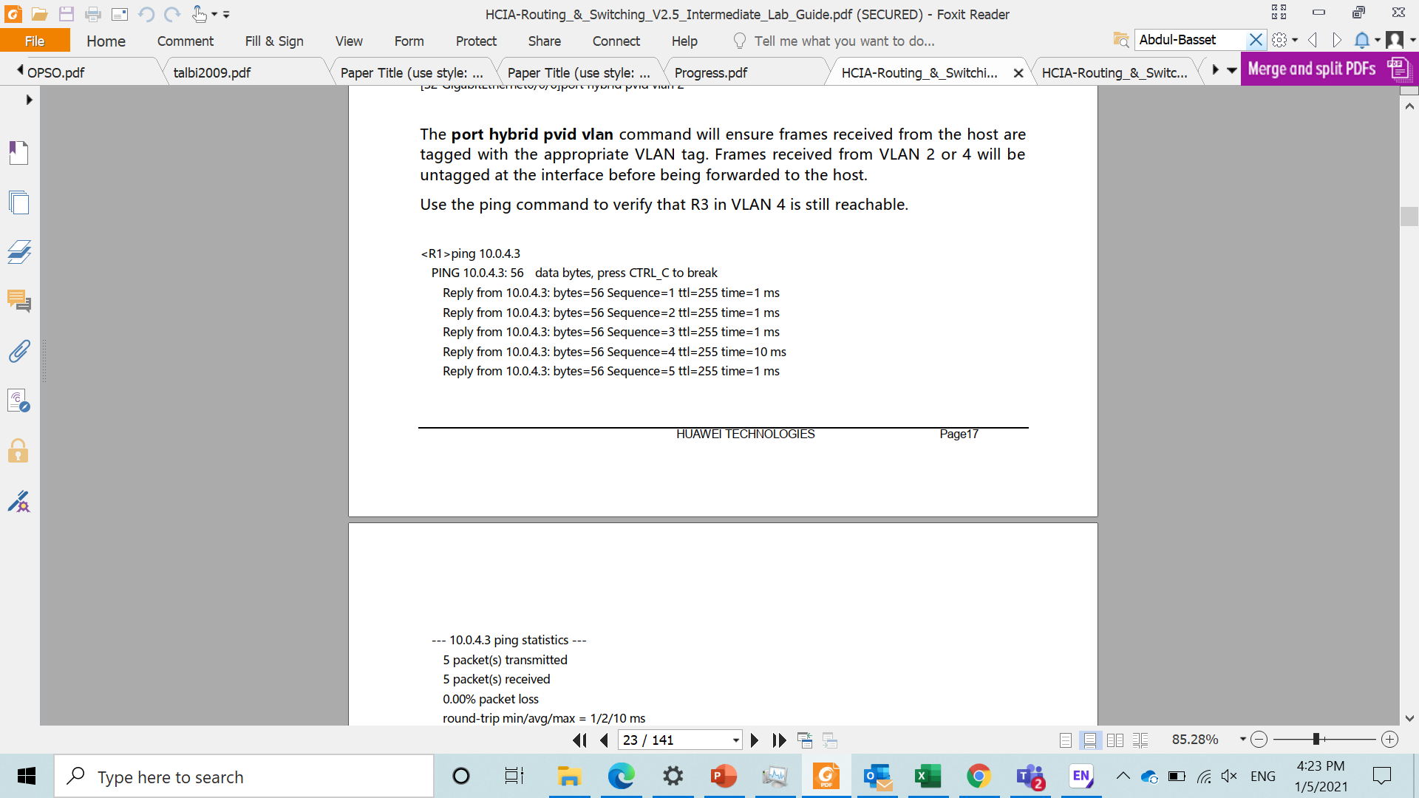
Configured a hybrid interface
The port hybrid pvid vlan command will ensure frames received from the host are tagged with the appropriate VLAN tag.
frames received from VLAN 2 or 4 will be intagged at the interface before being forwarded to the host.
Use the ping command to verify that R3 in VLAN 4 is still reachable

Slide 15
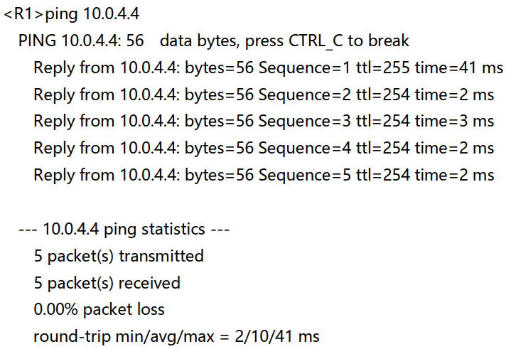
Configured a hybrid interface
Use the ping command to test whether S4 in VLAN2 is now reachable from R1 in VLAN4.
In using the hybrid port link type, frames originating from VLAN4 are now able to be received by VLAN2 and vice versa, whilst still being unable to reach the host address of 10.0.4.2 in VLAN3.

Slide 16

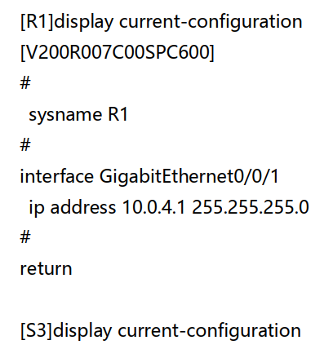
Final configuration

Slide 17

Final configuration

Slide 18
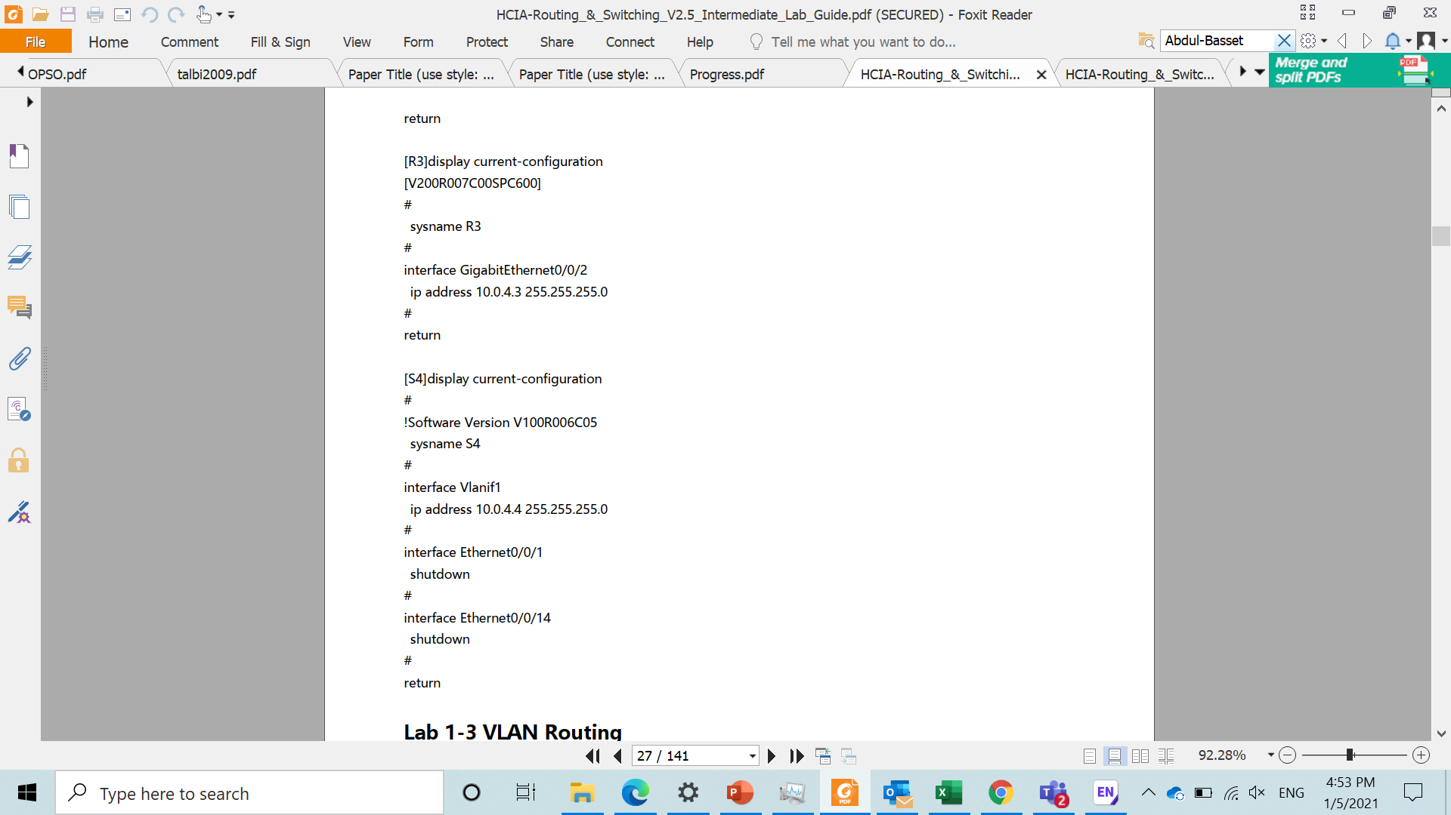
Final configuration

Slide 19
ASSIGNMENT
Draw a topo consist of 2 switches , 2 routers and 2 pcs.
Configure the routers and pcs as hosts.
put the routers under vlan2 and the pcs under vlan3.
Check the connectivity within same vlan and within different vlans.
-screenshot the command prompt.
LAB 8

Slide 20
Thank you

